Slide 1


Spell Checker
By: Team 4

Slide 2

Main Code
sentence = input("\033[38;5;231mType words to check its spelling:\033[0m\n") words_list = sentence.lower().split() start = time() dictionary = get_dictionary() mispelled_words = get_misspelled(dictionary, words_list) print_underlined(words_list, mispelled_words) suggestions = get_suggestions(dictionary, mispelled_words) print_suggestions(mispelled_words, suggestions) print(f"\033[38;5;231m\nProgram executed in: {time() - start} sec\033[0m")

Slide 3

Main Ideas

Slide 4





Main Ideas
1. Import the dictionary.
2. Import the user words.
3. Find the wrong words.
4. Find suggestions.
5. Print results.

Slide 5
1. Import the dictionary.
def get_dictionary(path="dictiony.txt"): """Reads the dictionary file ==> returns a list of its words""" f = open(path) dictionary = f.read().split() f.close return dictionary

Slide 6
1. Import the user words
sentence = input("\033[38;5;231mType words to check its spelling:\033[0m\n")
words_list = sentence.lower().split()
So
What is the “sentence.lower().split()” ?
I’m Engineer
i’m engineer
[ “i’m” , “engineer” ]
Wrong word !
Right word!
Right word!
Hard to control !
Hard to control !
Easy to control !

Slide 7


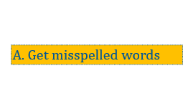
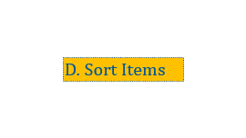
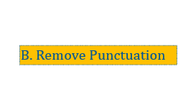

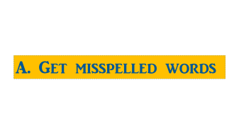
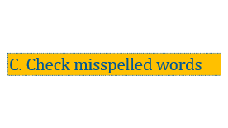

3. Find the wrong words
Not that easy
How to find wrong words?

Slide 8
A. Get misspelled words

Slide 9
A. Get misspelled words
def get_misspelled(dictionary, words): """Returns a list of misspelled words from user words""" misspelled_words = [] for word in words: word = rem_punct(word) if word not in misspelled_words and \ is_misspelled(dictionary, word): misspelled_words.append(word) return misspelled_words

Slide 10
B. Remove Punctuation

Slide 11
B. Remove Punctuation
def rem_punct(word): """ Removes punctuation from english words if exists """ if word[0] in "&-": word = word[1:] if word[-1] in ".,?!": word = word[:-1] return word

Slide 12
C. Check misspelled words

Slide 13
C. Check misspelled words
def is_misspelled(dictionary, word): """Checks spelling of a word ==> returns True (if the word is misspelled) or False (if the word is correct)""" if len(word) == 0 or word.isdigit(): return False else: return not binary_search(dictionary, word)

Slide 14
D. Sort Items

Slide 15
D. Sort Items
def selection_sort(alist, n2): n = len(alist) if n2 > n: n2 = n for i in range(n2): max_value = alist[i][1] max_position = i for j in range(i + 1, n): if alist[j][1] > max_value: max_value = alist[j][1] max_position = j alist[i], alist[max_position] = alist[max_position], alist[i] return alist[:n2]

Slide 16
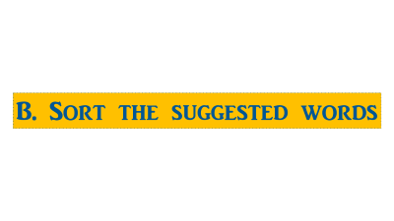
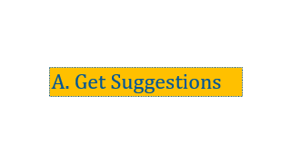
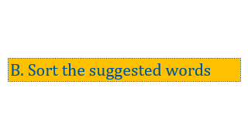

4. Find Suggestions
------------------------------------------------------------------------------------------------------------------------------------------------------------------------------------------------------------------------------------------------------------------------------------------------------------------------------------------------------------------------------------------------------------------------------------------------------------------------------------------------------------
------------------------------------------------------------------------------------------------------------------------------------------------------------------------------------------------------------------------------------------------------------------------------------------------------------------------------------------------------------------------------------------------------------------------------------------------------------------------------------------------------------

Slide 17
A. Get Suggestions

Slide 18
A. Get Suggestions
def get_suggestions(dictionary, misspelled_words, n=3): """Gets suggestions for each misspelled word ==> returns a dictionary of each misspelled word as a key and a list of suggestions for this word as a value: { misspelled_word: [list of its suggestions] } """ suggestions = {}
for word in misspelled_words: temp = [] s = SequenceMatcher() s.set_seq2(word) for item in dictionary: s.set_seq1(item) if s.real_quick_ratio() >= 0.65 and \ s.quick_ratio() >= 0.65 and \ s.ratio() >= 0.65: temp.append([item, s.ratio()]) suggestions[word] = selection_sort(temp, n) return suggestions

Slide 19
B. Sort the suggested words

Slide 20
B. Sort the suggested words
def selection_sort(alist, n2): n = len(alist) if n2 > n: n2 = n for i in range(n2): max_value = alist[i][1] max_position = i for j in range(i + 1, n): if alist[j][1] > max_value: max_value = alist[j][1] max_position = j alist[i], alist[max_position] = alist[max_position], alist[i] return alist[:n2]

Slide 21
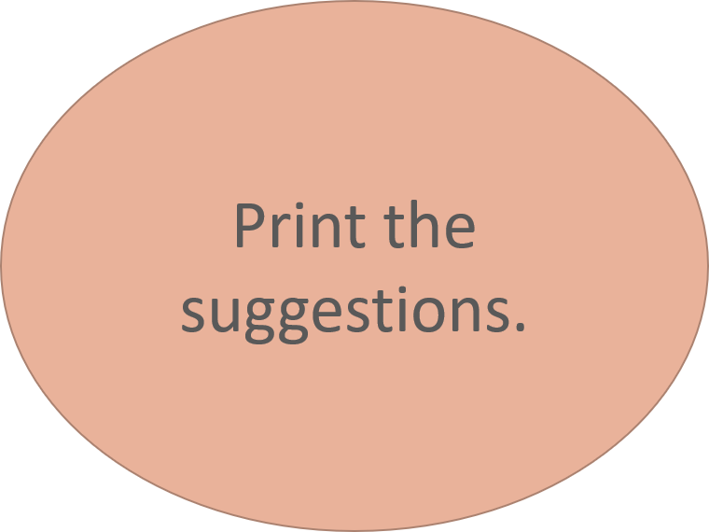
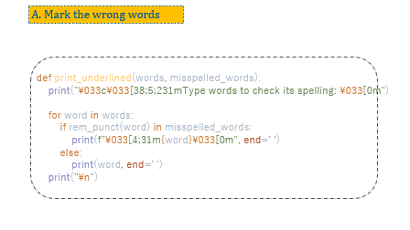
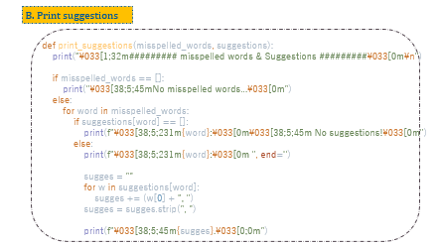
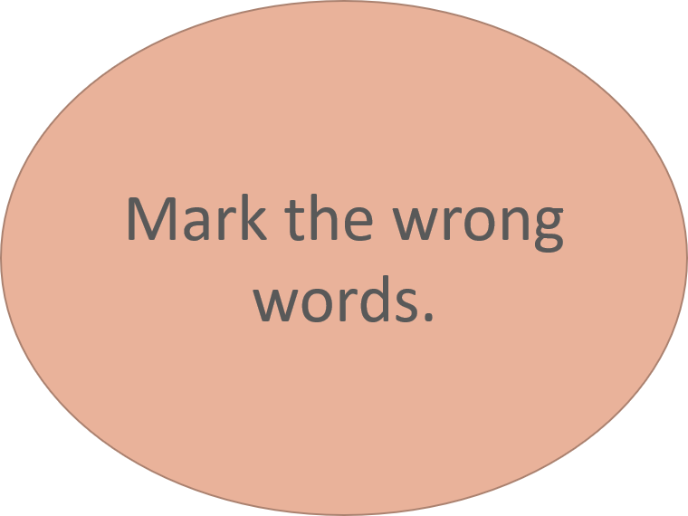
5. Print Results
1
2

Slide 22
A. Mark the wrong words
def print_underlined(words, misspelled_words): print("\033c\033[38;5;231mType words to check its spelling: \033[0m") for word in words: if rem_punct(word) in misspelled_words: print(f"\033[4;31m{word}\033[0m", end=' ') else: print(word, end=' ') print("\n")

Slide 23
B. Print suggestions
def print_suggestions(misspelled_words, suggestions): print("\033[1;32m######### misspelled words & Suggestions #########\033[0m\n") if misspelled_words == []: print("\033[38;5;45mNo misspelled words...\033[0m") else: for word in misspelled_words: if suggestions[word] == []: print(f"\033[38;5;231m{word}:\033[0m\033[38;5;45m No suggestions!\033[0m") else: print(f"\033[38;5;231m{word}:\033[0m ", end='') sugges = "" for w in suggestions[word]: sugges += (w[0] + ", ") sugges = sugges.strip(", ") print(f"\033[38;5;45m{sugges}.\033[0;0m")

Slide 24

Team Members
|Mohamed Abohend
|Mohamed Shams
|Yousef Khaled
|Omar Negm
|HaZem Shahawy
|Mohamed Adel
|Yousef Hamad
|Amr Elkafrawy
|Ahmed Elsberbawy
|Omar Reda
|Omar Osama
|Omar ElmeZayn
|Mohamed Elelemy
|Shereen Nasr
|Mohamed Gamal
|Eman Khayal
|Ebrahim Elawa
|MoaZ Ramdan
|Mohamed Saeed
| Maged Mohamed
| Ahmed Shaaban
Presented By : Abohend

